Slide 1
Final Report
SF – TIP – Batch9BD

Slide 2
Introduction
Mentor: Tuan Do Intern: Thanh, Anh, Tuan, Trieu, Sang, Duc, Hoa
SF internship management: Lam Le

Slide 3

Content
I. Researched topic
HTML, CSS
JavaScript
Git
React JS
Redux
II. Project overview
Introduction Shoe shop
Backend
III. Demo

Slide 4
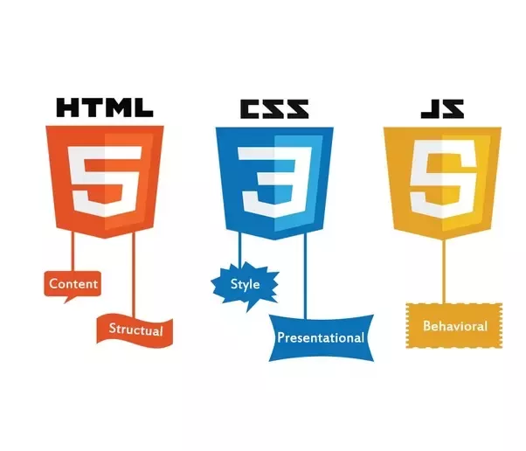
Frontend Concepts

Slide 5
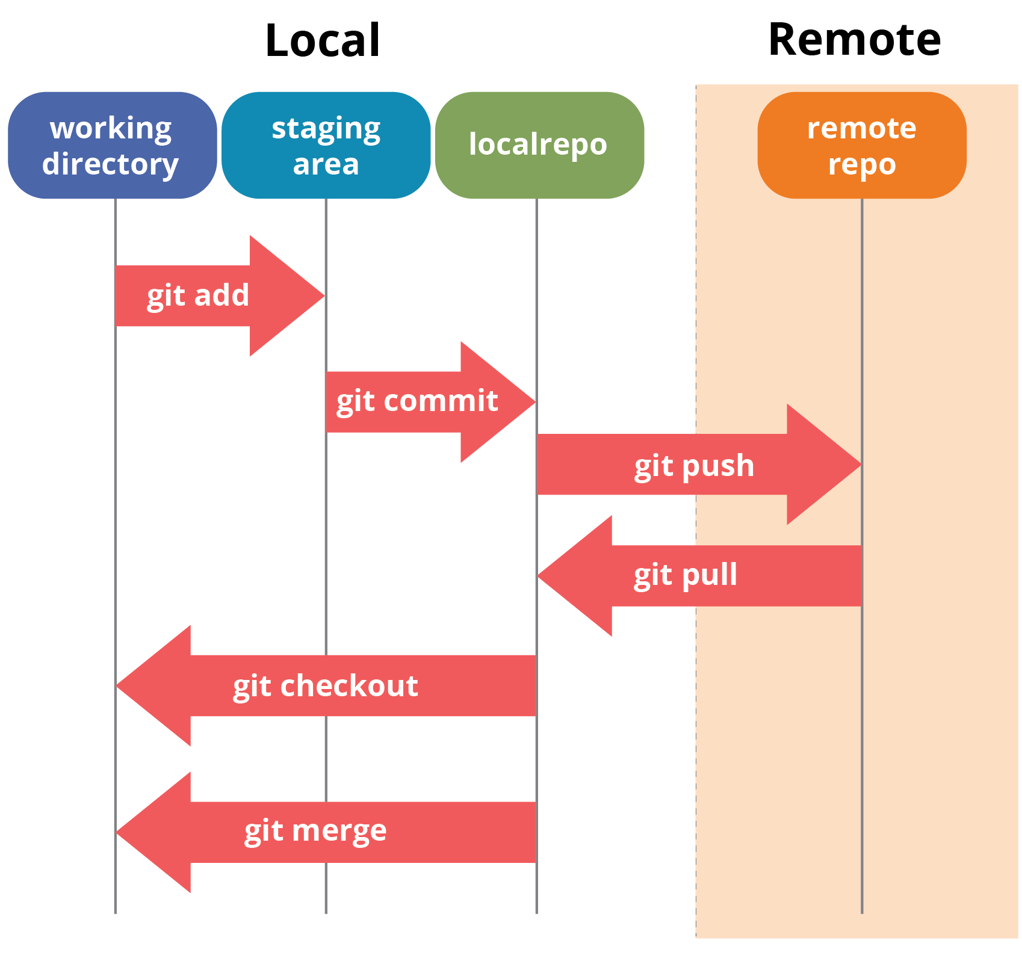
Git

Slide 6

React JS

Slide 7
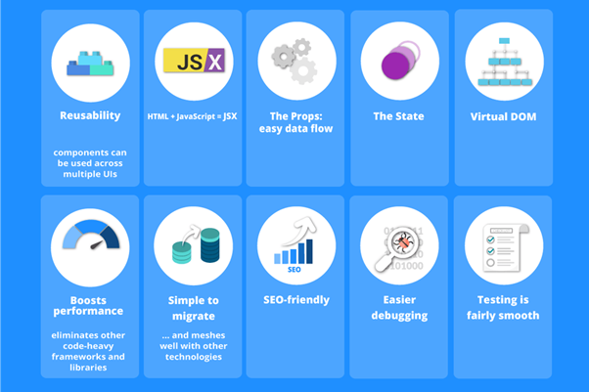
React

Slide 8
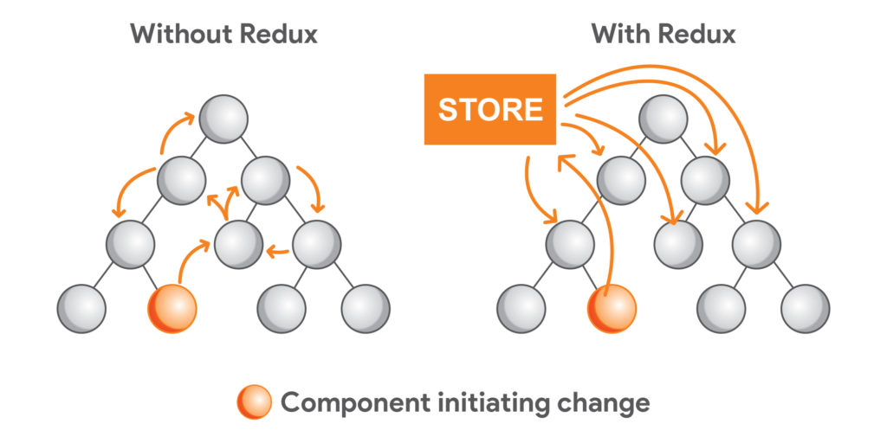
Redux

Slide 9
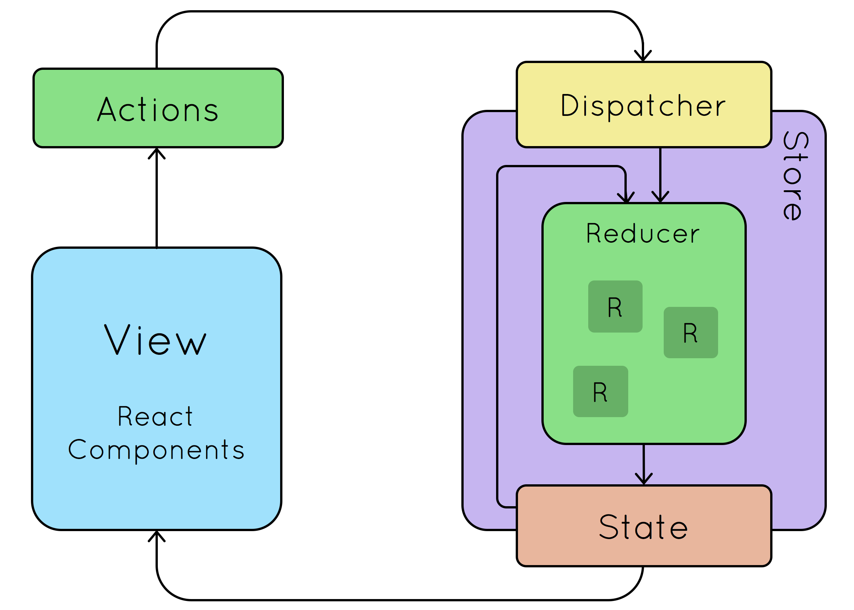
Redux

Slide 10
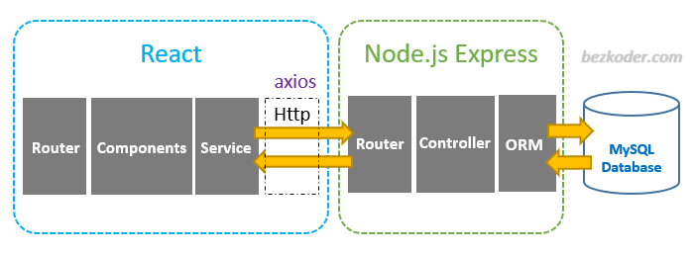
Working with API
Database

Slide 11

Postman

Slide 12
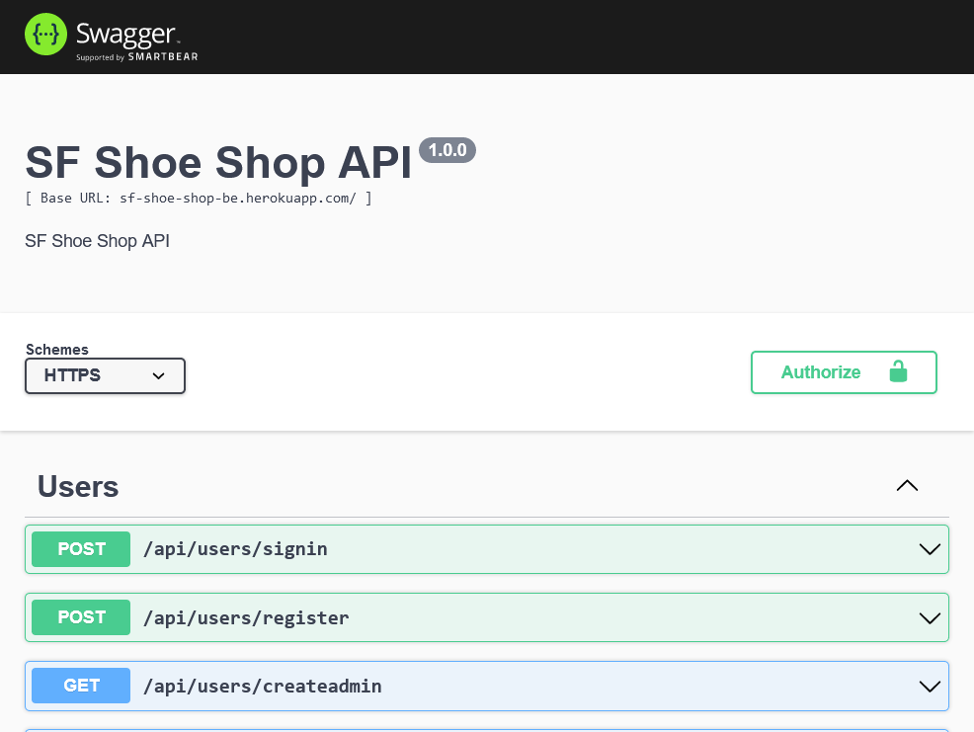



Backend

Slide 13
Project Overview
Customer page display list product and view details.
Customer can add product to cart and checkout.
Admin page to manage products and users.

Slide 14





Project Overview

Slide 15
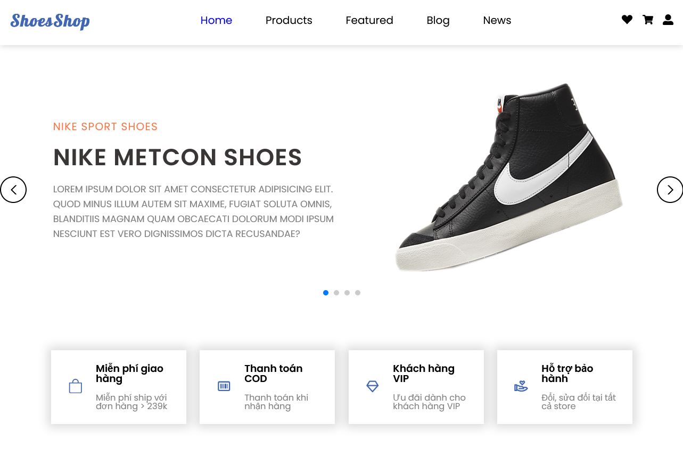
Home Page
Shoe Shop

Slide 16
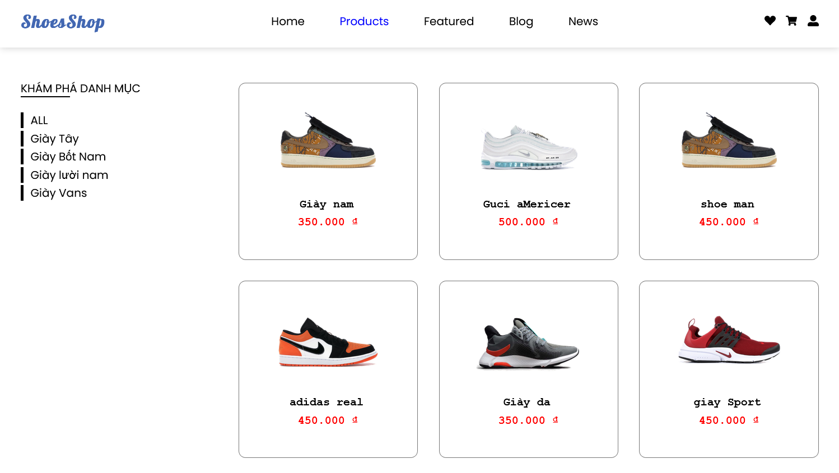
Products List

Slide 17
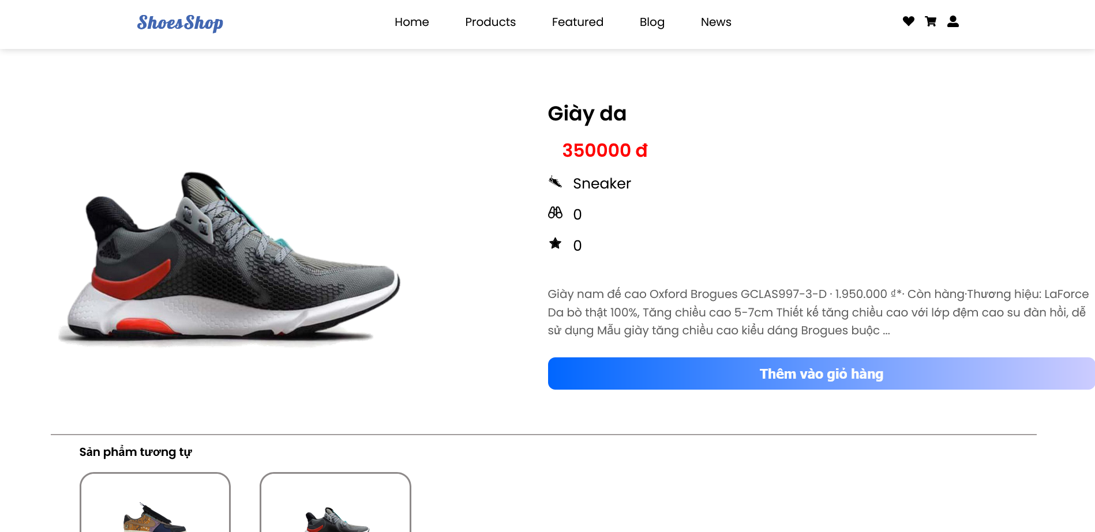
Product Details

Slide 18
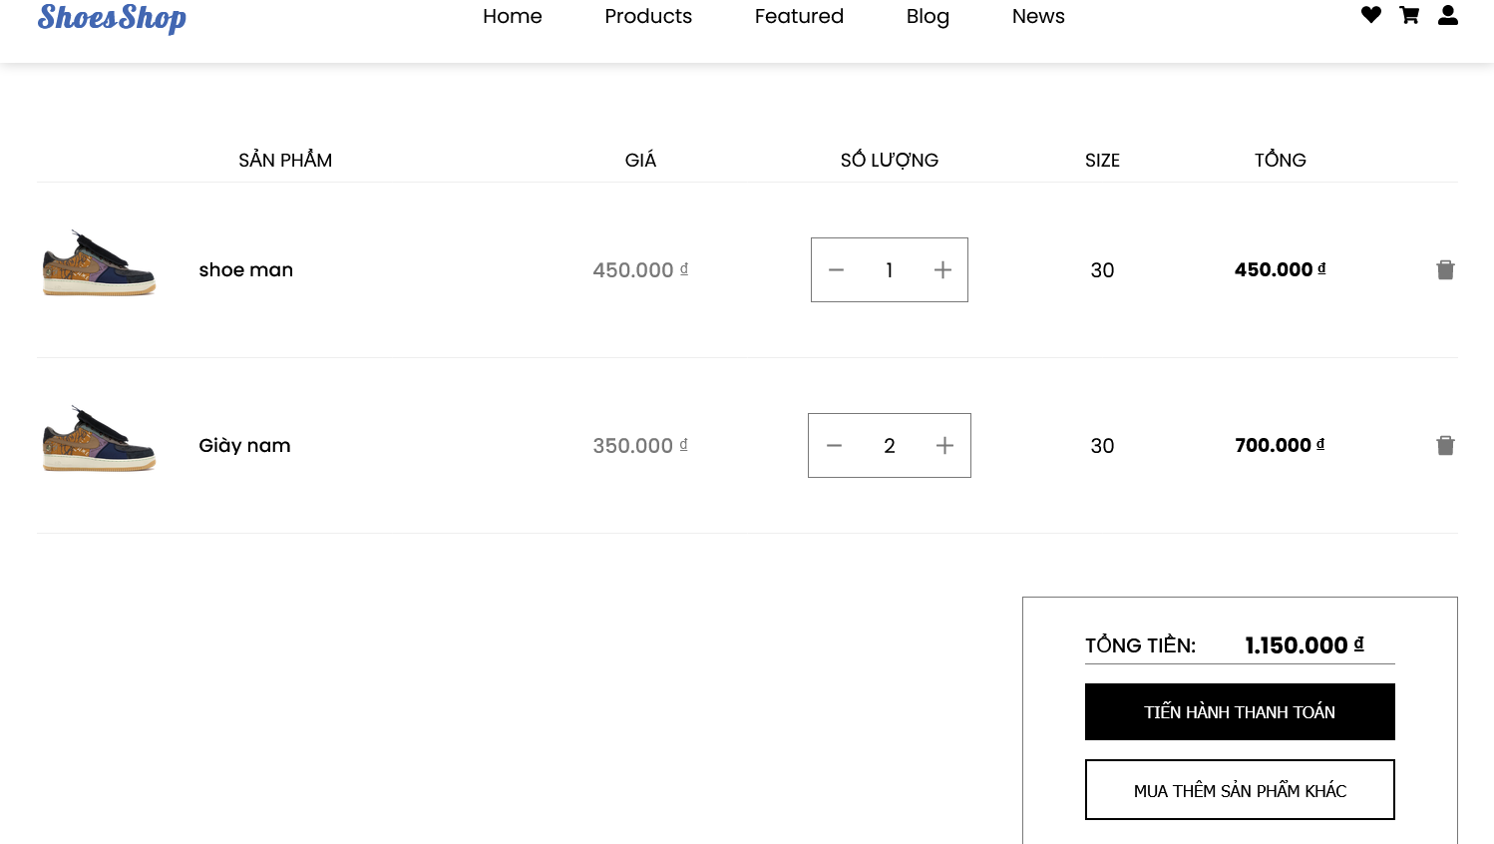
Shopping Cart

Slide 19
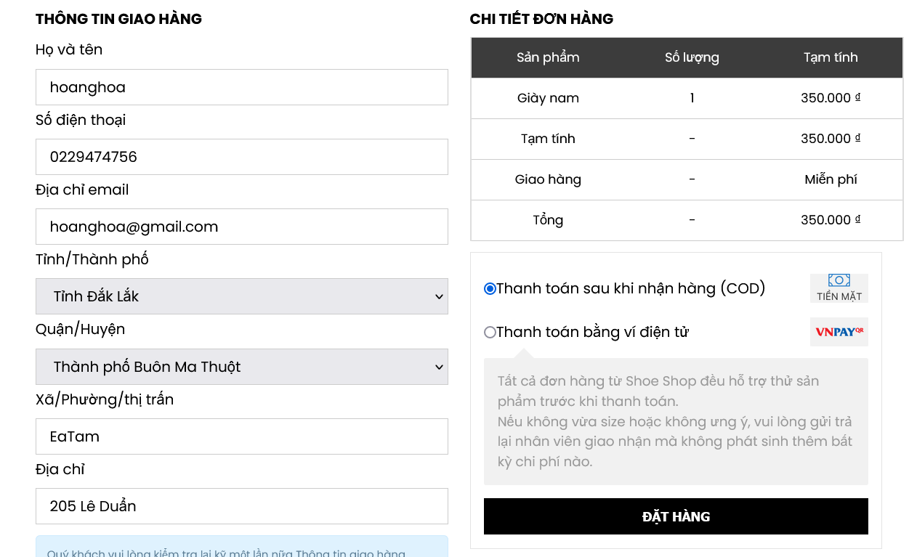
Checkout Page

Slide 20
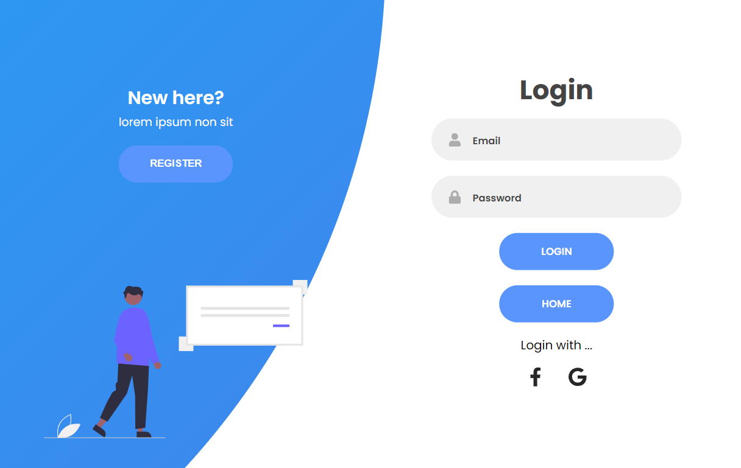
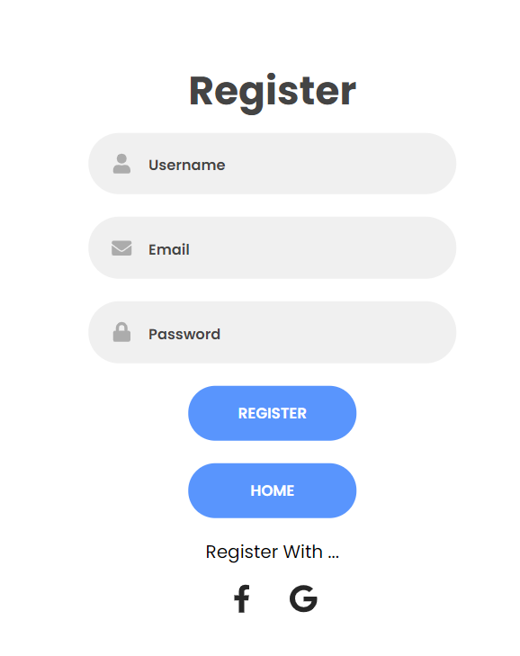
Authentication Page

Slide 21
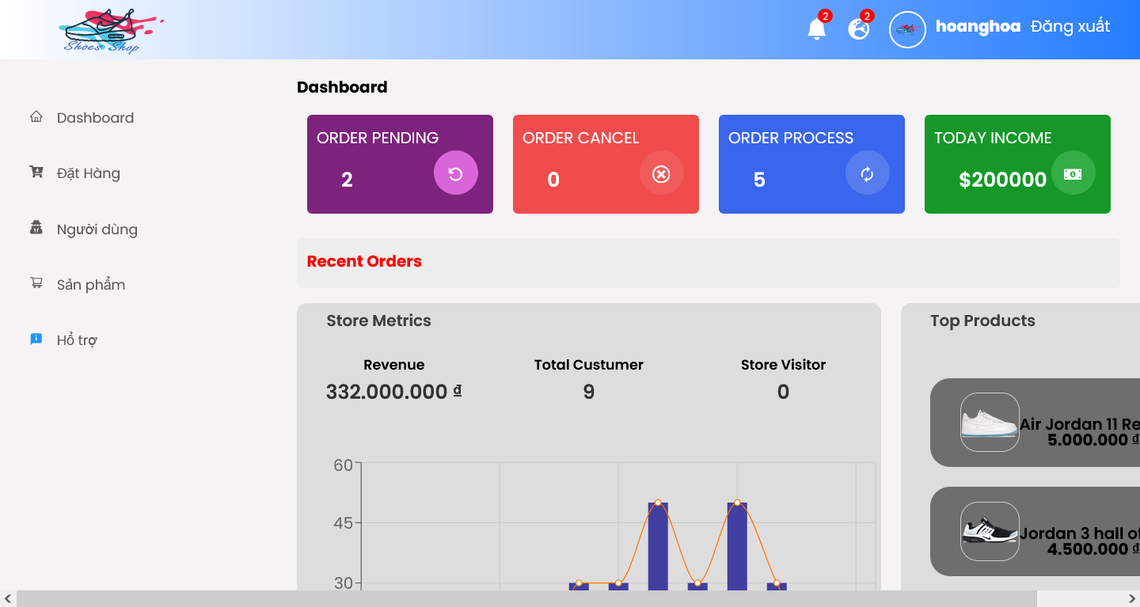
Admin Dashboard

Slide 22
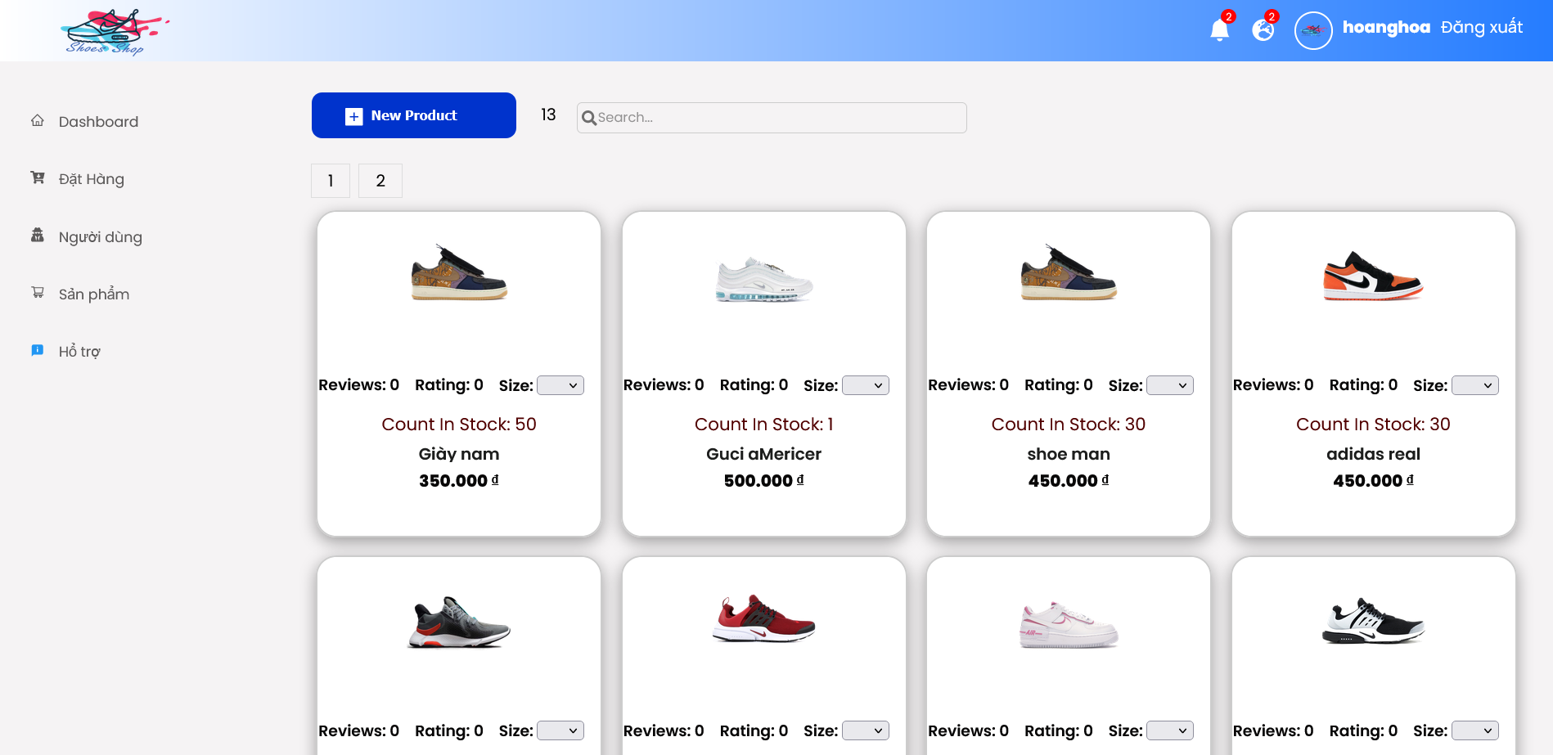
Admin Products

Slide 23
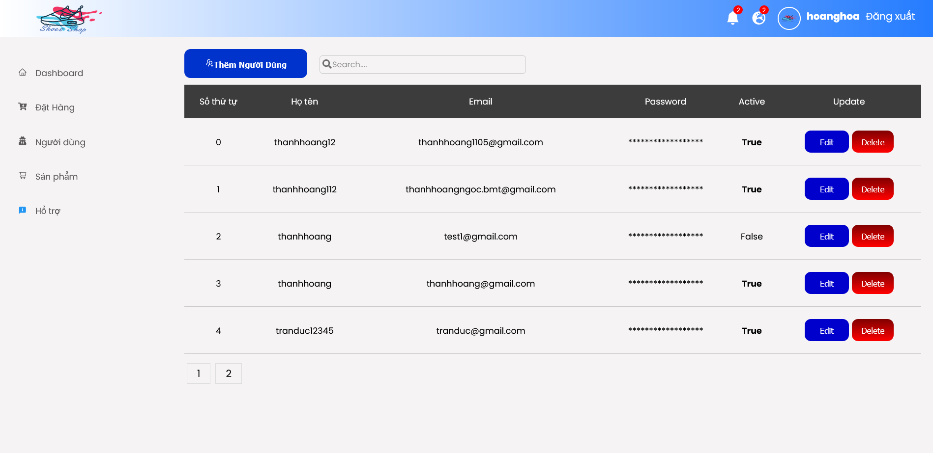
Admin User

Slide 24
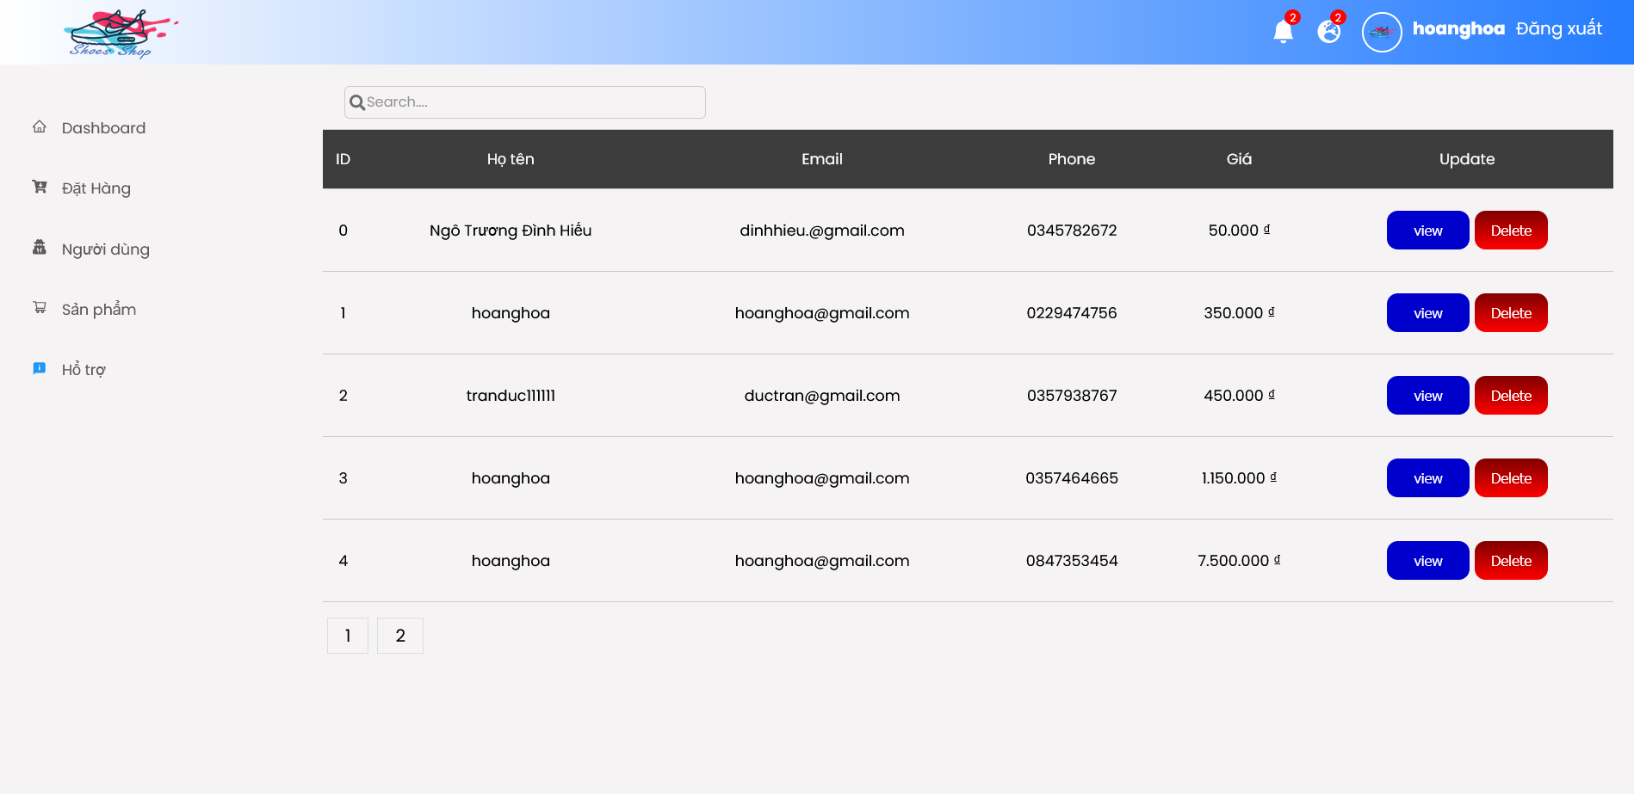
Admin Orders

